Slide 1
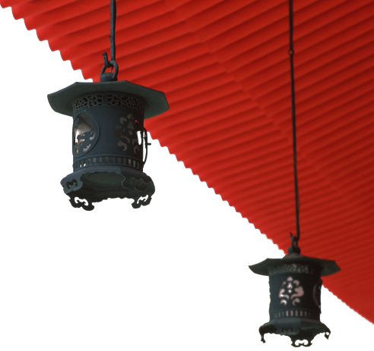

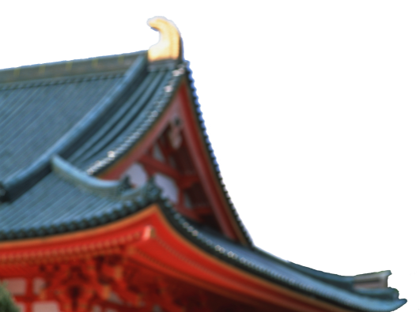
中国文化概况
A GLIMPSE OF CHINESE CULTURE

Slide 2
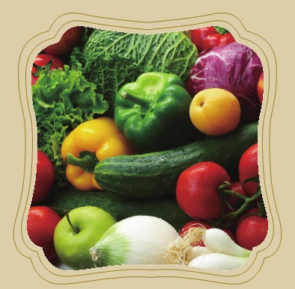
Chapter 8 Culinary Culture

Slide 3

学习目标
了解中国饮食文化；
认识中国茶酒文化.

Slide 4
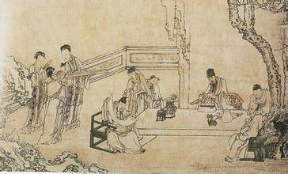
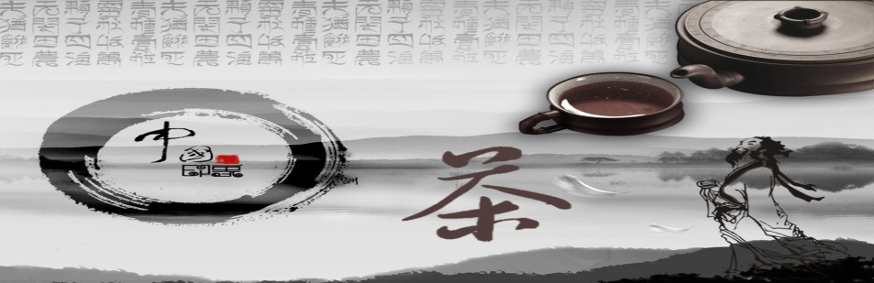
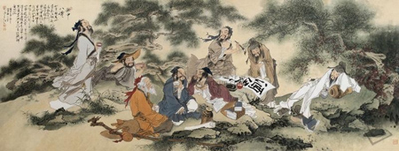
1
2
Overview
3
Lead-in Activity
Chinese
diet
Discussion &
Presentation

Slide 5
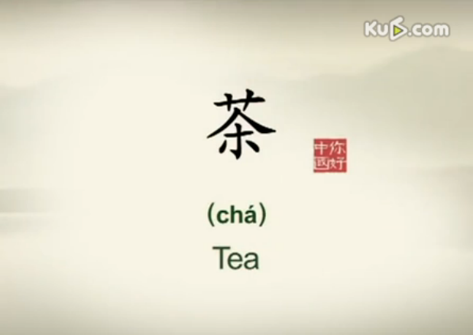
Lead-in Activity
Watch and & Think
Watch the video clip and discuss:
Do you know anything about Chinese tea?
What kind of tea do you like best?

Slide 6
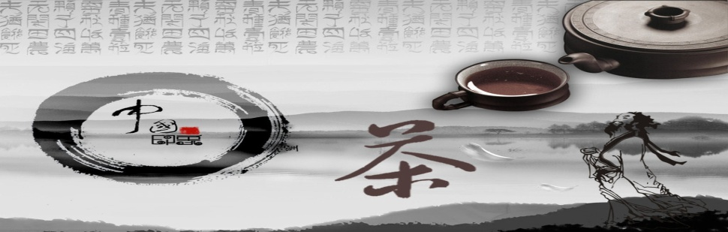
1
2
Overview
3
Lead-in Activity
Chinese
diet
Discussion &
Presentation

Slide 7
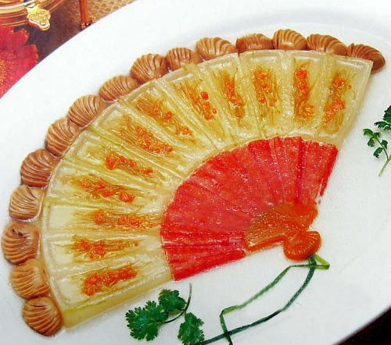
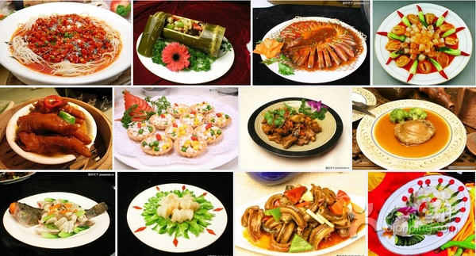
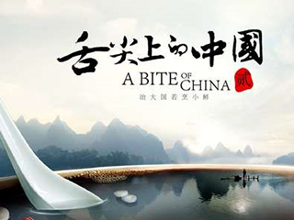
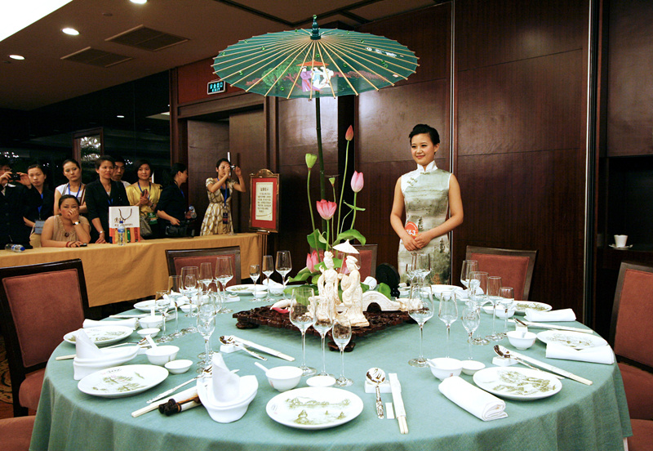
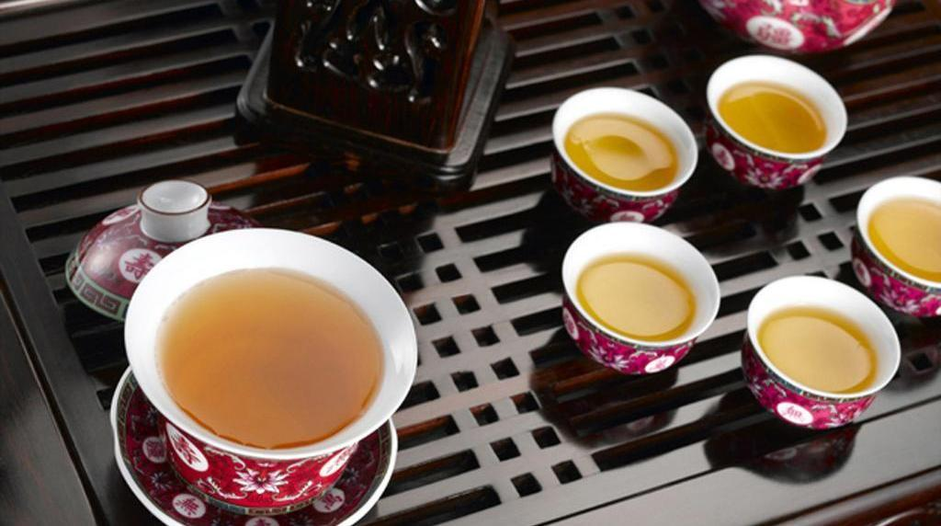
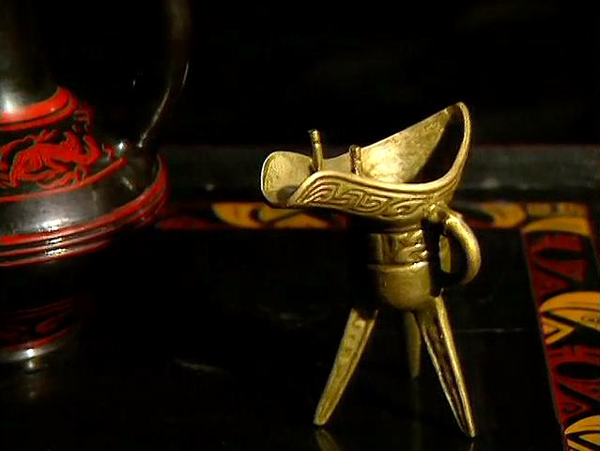
Culinary Culture
1
2
3
4
5
6
Features of
Chinese
Food
Eight Regional
Cuisines
Chinese Delicacy
A Bite of China
Table Manners
Chinese Tea
Chinese Wine

Slide 8
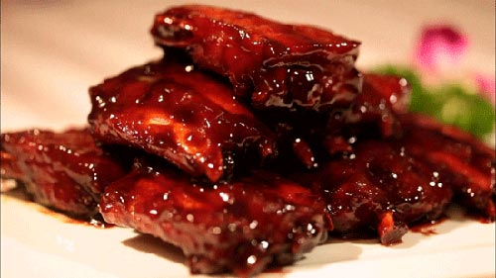
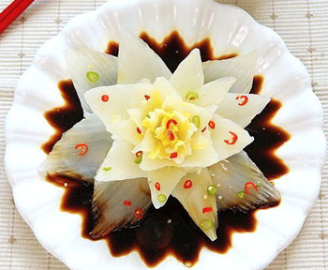
Features of Chinese Food
Colour, Aroma, and Taste
Colour: the beautiful color
the layout
the design
Aroma: the fragrant smell
the appetising smell
Taste: tasting
the appreciation of seasonings 调味品
the appreciation of texture

Slide 9
Features of Chinese Food
Cooking Methods
locality and climate are important
methods: boiling (煮), stewing (炖，煨，焖), frying (煎), stir-frying (炒), quick-frying (爆), deep-frying (炸), frying and simmering(扒)，sautéing (快煎),smoking(熏)，roasting and barbecuing(烤) baking (烘), steaming (蒸) and scalding (白灼)，etc.

Slide 10
Features of Chinese Food
Seasonings
taste mainly depends on the seasonings.
many tastes—salty (salt, soy sauce), sweet (sugar, honey), sour (vinegar), fragrant (sesame oil,芝麻油 coriander香菜, wine), spicy(chilli, garlic, ginger), tangy浓烈的(monosodium glutamate or MSG), bitter(dried tangerine陈皮, bitter apricot kernel苦杏仁),etc.

Slide 11
Features of Chinese Food
Yin-yang Principle
Each food has its own characteristics of yin or yang.
Yin foods : thin, cold ,low calories.
Boiling makes food yin.
Yang foods : rich, spicy, hot ,high calories.
Frying makes food yang.

Slide 12
Features of Chinese Food
Medicinal Function
based on traditional Chinese herbal medicine practice
combines strictly processed traditional Chinese medicine with
traditional culinary materials
produce delicious food with health-restoring functions
a food tonic is much better than a medicine in fortifying one's
health

Slide 13

Culinary Culture
1
2
3
4
5
6
Features of
Chinese
Food
Eight Regional
Cuisines
Chinese Delicacy
A Bite of China
Table Manners
Chinese Tea
Chinese Wine

Slide 14
Eight Regional Cuisines
dishes vary from region to region
tastes also differ regionally because of the
climatic differences
“sweet in the south, salty in the north, sour in
the west and spicy in the east”

Slide 15
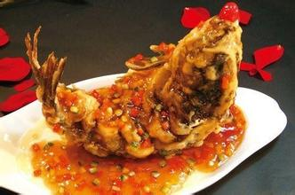
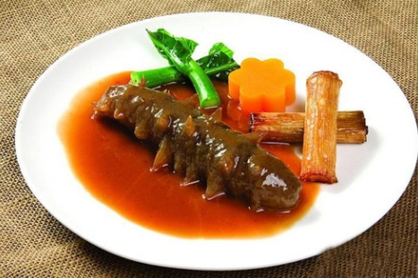
Eight Regional Cuisines
Shandong Cuisine
also known as Lucai（鲁菜）
emphasis on aroma, freshness,
crispness, tenderness ,use of
minimal fat
seasonings: sauce paste酱汁, onion洋葱,
garlic, taste pungent

Slide 16
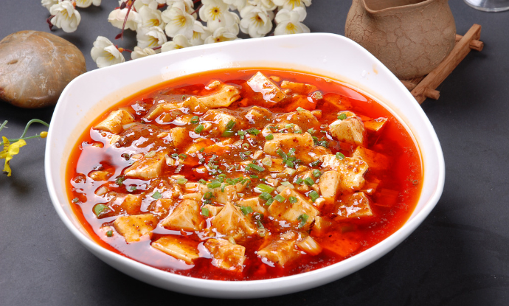
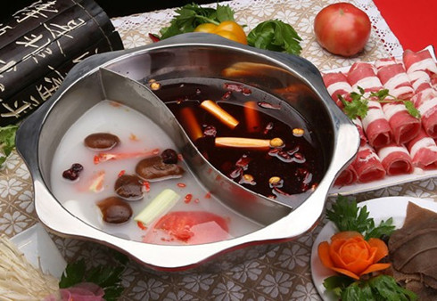
Eight Regional Cuisines
Sichuan Cuisine
also known as Chuancai(川菜)
spicy and flavourful
emphasises the use of chili辣椒, pepper,
Chinese prickly ash花椒
garlic, ginger and fermented soybean
发酵大豆

Slide 17
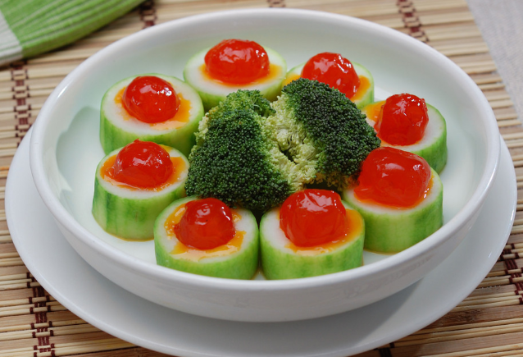
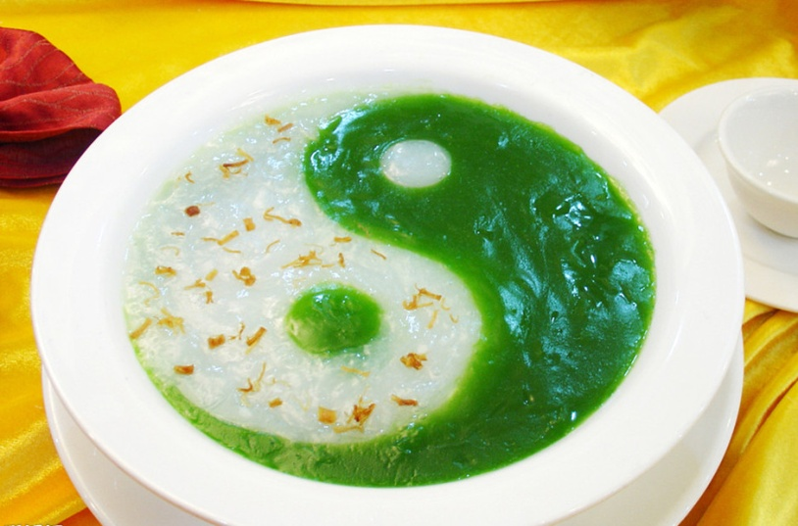
Eight Regional Cuisines
Guangdong Cuisine
also known as Yuecai (粤菜).
fresh, crisp, tender, lightly
seasoned.
roasting, stir-frying翻炒爆炒, sautéing,
deep-frying油炸, stewing and
steaming.
porridges and soups

Slide 18
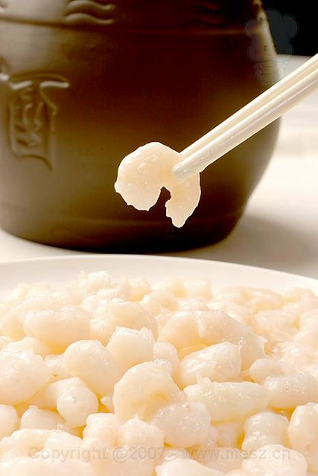
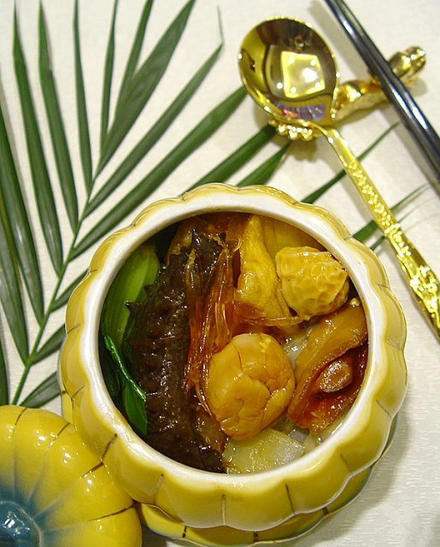
Eight Regional Cuisines
Fujian Cuisines
also known as Mincai（闽菜）
light taste, sweet and sour flavour
strictly selected ingredients
seafood dishes

Slide 19
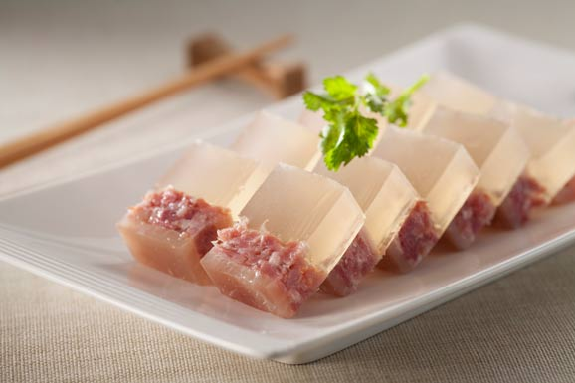
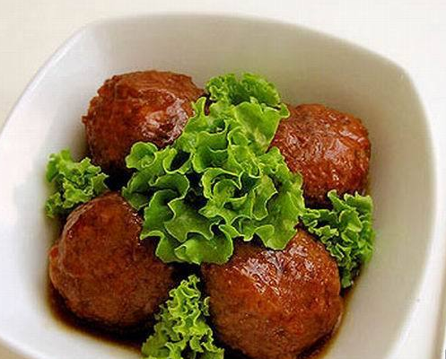
Eight Regional Cuisines
Jiangsu Cuisines
also known as Sucai (苏菜)
distinctive style独特风格, characteristically
sweet taste
original flavour of cooking
materials
strict election of ingredients
exquisite workmanship
elegant shapes

Slide 20
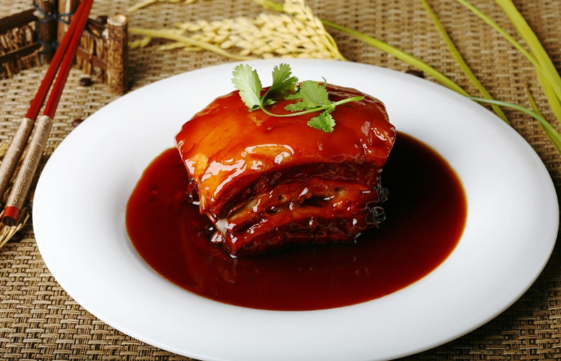
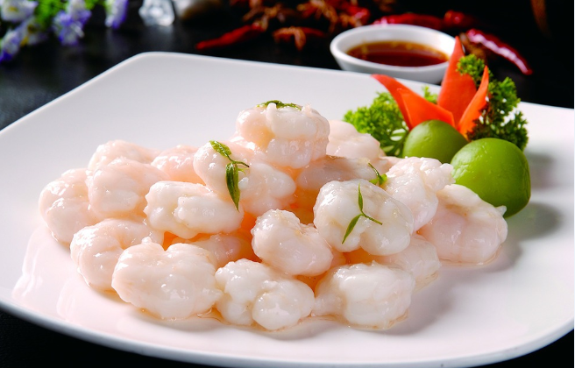
Eight Regional Cuisines
Zhejiang Cuisine
also known as Zhecai (浙菜)
freshness, tenderness, softness,
smoothness with mellow fragrance
comprises the specialties of
Hangzhou, Ningbo, shaoxing

Slide 21
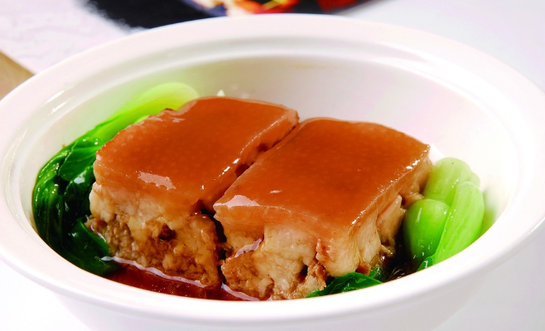
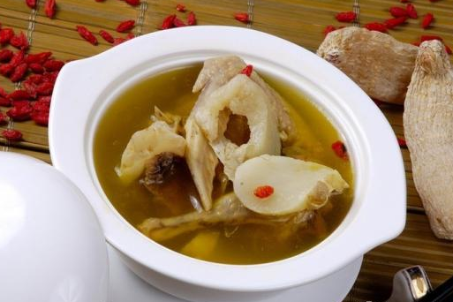
Eight Regional Cuisines
Anhui Cuisine
also known as Huicai (徽菜)
elaborate selection of cooking
ingredients
strict control of the cooking process
original taste and nutrition of the
ingredients
slightly spicy and salty

Slide 22
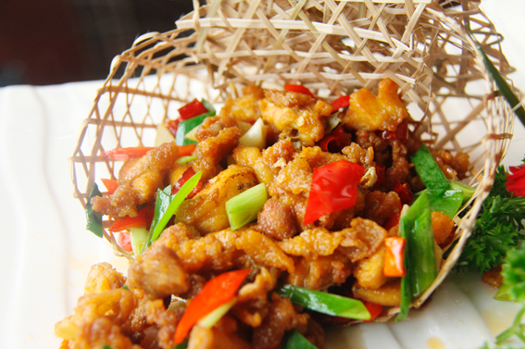
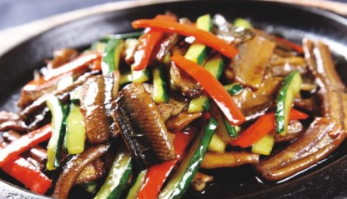
Eight Regional Cuisines
Hunan Cuisine
also known as Xiangcai (湘菜)
akin to类似于 the chili-rich Sichuan Cuisine
dense pungent flavour
chili, pepper, shallot青葱
hot, sour flavour, fresh aroma,
greasiness油腻, deep colour, etc

Slide 23
Culinary Culture
1
2
3
4
5
6
Features of
Chinese
Food
Eight Regional
Cuisines
Chinese Delicacy
A Bite of China
Table Manners
Chinese tea
Chinese Wine

Slide 24
Chinese Delicacy – A Bite of China
a documentary television programme produced by CCTV
intended to familiarise people around the world with
Chinese food culture, local customs, great Chinese heritage
introduces the history, stories behind food
intricacy and cultural origins
how much imagination and tradition goes into food of China
gained widespread popularity at home and abroad

Slide 25
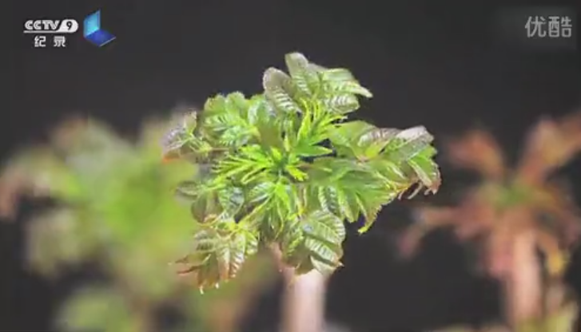
Chinese Delicacy – A Bite of China
Now watch a video clip of A Bite of China, and discuss why it is so popular.

Slide 26
Culinary Culture
1
2
3
4
5
6
Features of
Chinese
Food
Eight Regional
Cuisines
Chinese Delicacy
A Bite of China
Table Manners
Chinese Tea
Chinese Wine

Slide 27
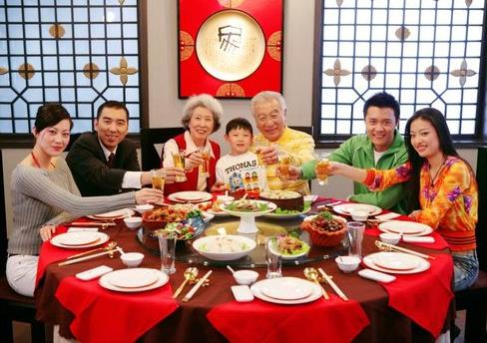
Table Manners
Arrangement of Seats
the host prepares adequate seats for the guests
Specific seats for the elderly or people of high status(northern side of the table or directly face the entrance to the room)
“honored south, humble north”

Slide 28
Table Manners
Toast
the host propose a toast saying “Drinking first to show respect”
toast with the word ganbei (bottoms up)
three toast with the entire company, rather than one separate toast for every individual present
some other toasts: toast to your health
toast to our friendship

Slide 29
Table Manners
Serving Courses
from cold to hot
hot entrees 热盘should be served starting on the left of the seat across from the main guests.
soup served next
local staples本地主食 are served last
over-order food

Slide 30
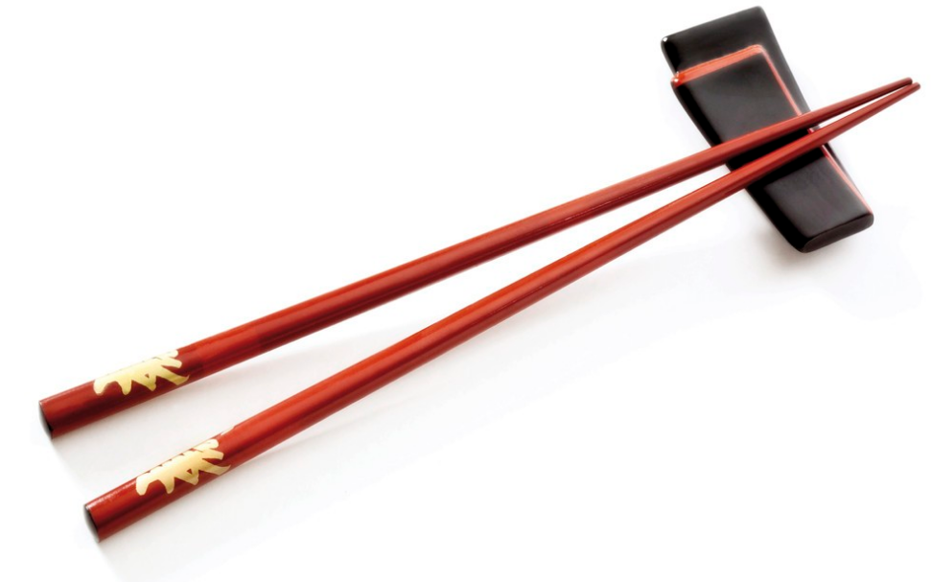
Table Manners
Chinese Chopsticks
Host may pick up some dishes for gusts with his own chopsticks(a sign of politeness and hospitality)
Hold chopsticks in the middle ,make sure the ends are even
Don’t stick chopsticks upright in the rice bowl
Don’t tap on the bowl with chopsticks

Slide 31
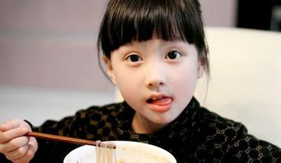
Table Manners
Chinese Chopsticks
Avoid sucking the ends of chopsticks or keeping them in mouth for a long time
Never point at someone with chopsticks
Don’t use chopsticks to pick food
“stand properly, sit properly and eat properly”

Slide 32
Culinary Culture
1
2
3
4
5
6
Features of
Chinese
Food
Eight Regional
Cuisines
Chinese Delicacy
A Bite of China
Table Manners
Chinese Tea
Chinese Wine

Slide 33
Chinese tea
Tea plays an important role in Chinese people’s daily life
China is the first country to grow, produce and drink tea
the art of making and drinking,now focuses on method of brewing tea, the drinking utensils, serving etiquette

Slide 34
Chinese tea
Tea classification
Five types:
green tea (绿茶)
black tea (红茶)
oolong tea (乌龙茶)
compressed tea (砖茶: brick tea)
scented tea (花茶)
Some minor types are white tea and yellow tea

Slide 35
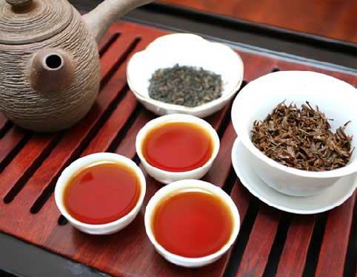
Chinese Tea
Tea classification—Black tea
fermented before baking
the tea liquid and tea leaves are reddish black
tastes sweet
can facilitate the fostering of yang energy
erase the greasiness in the human body

Slide 36
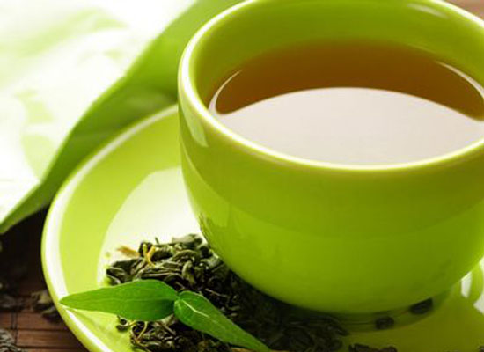
Chinese tea
Tea classification—Green tea
unfermented, the most natural of all types of Chinese tea
tea liquid and tea leaves are greenish
has the most medicinal value, the least caffeine 咖啡因

Slide 37
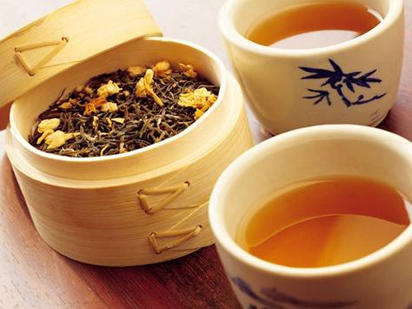
Chinese Tea
Tea classification— oolong tea
sits half way between green tea and black tea in the sense that it's half- fermented
leaves are green in the middle and red on the edges as a result of being soften
medicinal function

Slide 38
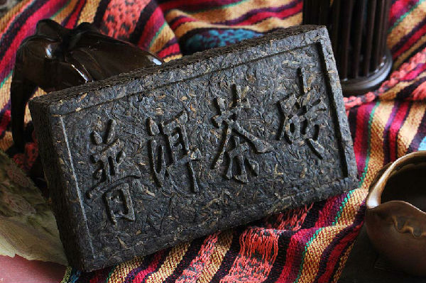
Chinese Tea
Tea classification—compressed tea
made by compressing steamed tea leaves into molds such as bricks, cakes, columns, etc
can be stored for years or even decades
aged Compressed tea has a gentle flavor

Slide 39
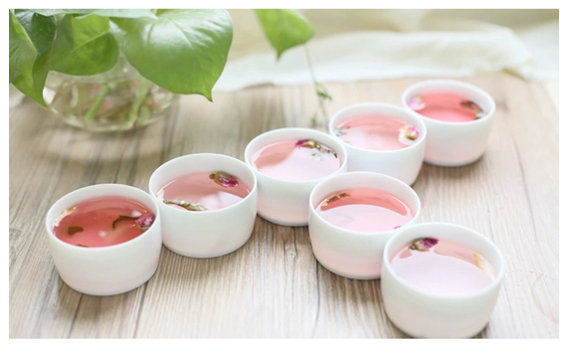
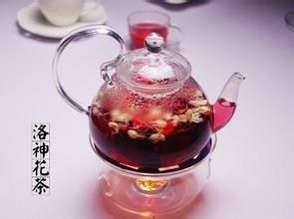
Chinese Tea
Tea classification—scented tea
a mixture of flowers
finely blended and sealed for a time
light-to-medium aroma, medium-to-strong aroma

Slide 40
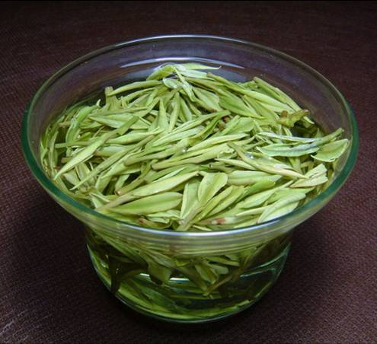
Chinese Tea
Tea classification—white tea
non-fermented
non-rubbed 没有搓
with natural fragrance.
Famous varieties include Silver Needle (白毫银珍) and White Peony (白牡丹）

Slide 41
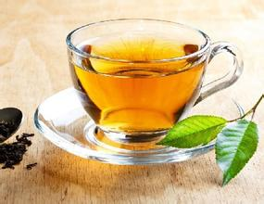
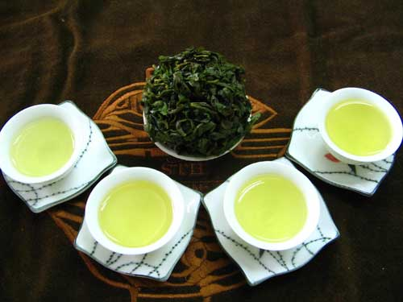
Chinese Tea
Tea classification—yellow tea
yellow leaves and yellow tea colour
an uncommon class of Chinese tea.
mild and refreshing

Slide 42
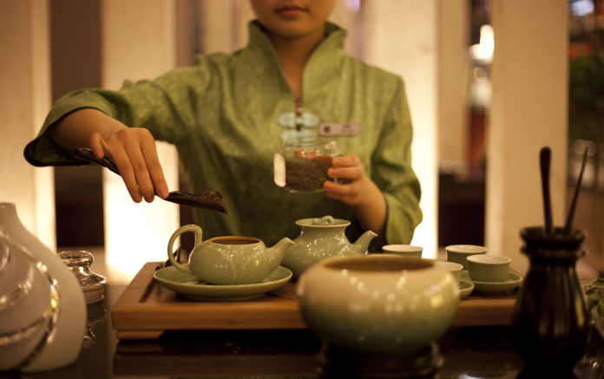
Chinese Tea
Tea Etiquette
a symbol of togetherness
a sharing of something enjoyable
a way of showing respect to gusts
ask for the preference of the guests before making the tea
the water should not be too hot
“full cup for wine and half cup for tea”

Slide 43
Chinese tea
Three Cups of Tea of the Bai Ethinic Group
the famous custom of the Bai ethnic group
greet with this warm and unique ceremony
three cups of tea
The first cup: made from local bitter leaves; medicinal.
The second cup: made from walnuts (核桃), cheese and
sugar; sweet.
The third cup: made by mixing prickly ash, ginger and
Chinese cinnamon (肉桂) with honey and bitter tea;
pungent, with a distinct aftertaste.

Slide 44
Chinese tea
What does the three cups of tea symbolize?
The three cups of tea are symbolic of the three stages of one’s life journey:
going through all kinds of hardships
exploring the joy of life
recalling both bitter and happy experiences
头苦，二甜，三回味

Slide 45
Culinary Culture
1
2
3
4
5
6
Features of
Chinese
Food
Eight Regional
Cuisines
Chinese Delicacy
A Bite of China
Table Manners
Chinese Tea
Chinese wine

Slide 46
Chinese Wine
Wine feast
“Marriage wine feasts”
“one-month-old wine feasts”
“Hundredth-day wine feasts”
“Longevity wine feasts”
“ wine feast for setting a roof beam in place”
People hold different wine feasts on different occasions

Slide 47
Chinese Wine
Drinkers’ wager game
a particular method in China to help create more joyous
atmosphere while drinking
used as a penalty to urge drinkers to drink more,
to create a more cheerful atmosphere.
forms depend on drinkers’ social status, literacy status,
and interest

Slide 48
Chinese Wine
Drinkers’ Wager Game
General Game
Ladies attending banquets may play general games:
telling jokes
solving riddles
passing down a flower to the beats of a drum

Slide 49
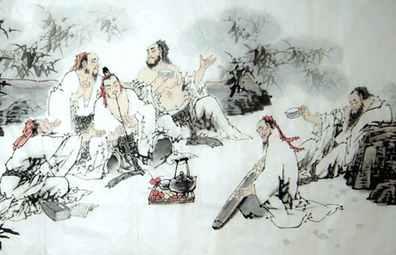
Chinese Wine
Drinkers’ Wager Game
Literary Game
more popular with scholars and intellectuals
composing poems
solving word puzzles
guessing riddles

Slide 50
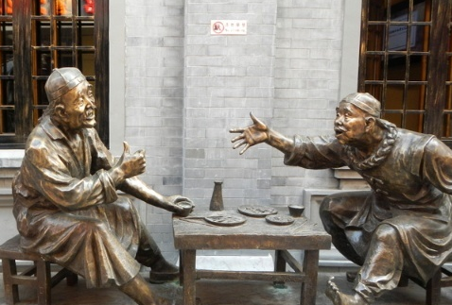
Chinese Wine
Drinkers’ Wager Game
Competing Game
archery射箭
arrow pitching投壶
dice throwing (掷骰子)
finger guessing (can played by two drinkers)

Slide 51
Chinese Wine
Alcohol and Social Activities
Alcohol and Business
alcohol plays an integral role in social life.
serves to deepen and strengthen the bonds of friendship
a way to relieve misunderstanding and animosity
Alcohol and arts
have a greater impact on Chinese artists
can free people from inhabitions
an important way to unleash artistic and creative talents

Slide 52
Chinese Wine
Alcohol and Social Activity
Alcohol and health
moderate drinking is good for their health.
a little alcohol periodically to maintain their vitality
and health.
soak traditional Chinese medicine in liquor to achieve
a better effect.
Inappropriate consumption can cause alcoholism

Slide 53
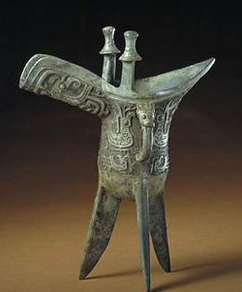
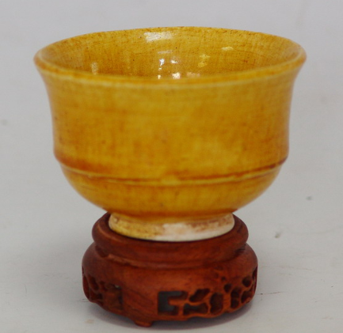



Chinese Wine
Wine set (酒具)

Slide 54
1
2
Overview
3
Lead-in Activity
Chinese
diet
Discussion &
Presentation

Slide 55
Discussion
Comprehension:
Fill in the following table with the information you leran from the reading text.
Eight Regional cuisines | Food features | Typical dishes
Shandong Cuisine
Sichuan Cuisine
Guangdong Cuisine
Fujian Cuisine
Jiangsu Cuisine
Zhejiang Cuisine
Anhui Cuisine
Hunan Cuisine

Slide 56
Discussion
Term translation:
1 八大菜系
2 老火靓汤
3《舌尖上的中国》
4 乌龙茶
5 交杯酒
eight regional cuisines
double-stewed soup
A Bite of China
oolong tea
arm-crossed wine

Slide 57
Discussion
The last few years have witnessed an increasing number of cafés in China. Compared with cafés, teahouses have less appeal among young people. Discuss with your partner whether coffee, which is popular with young Chinese people, poses a great threat to Chinese tea culture. Then share your opinions with the class.

Slide 58
Students’ Presentation
You have a foreign friend who is invited to go for a typical Chinese dinner party. He is asking you for suggestions on the table manners in China in order not to offend his host. Try to explain to him the basic rules of Chinese table manners and give him some tips on exercising proper table manners.

Slide 59
The End

